Slide 1
Predicate Resolution
Exercise 4.3

Slide 2
4. Using a refinement of predicate resolution prove:
⊢(∀x)(P(x)→Q(x))→((∀x)P(x)→(∃x)Q(x))
⊬((∃x)P(x)∧(∃x)Q(x))→(∀x)(P(x)∧Q(x))

Slide 3
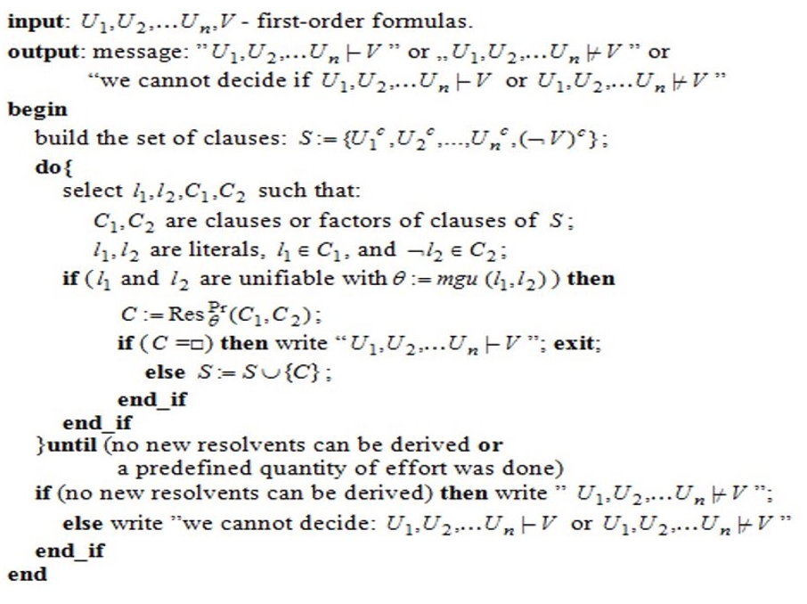
The algorithm for Predicate Resolution

Slide 4
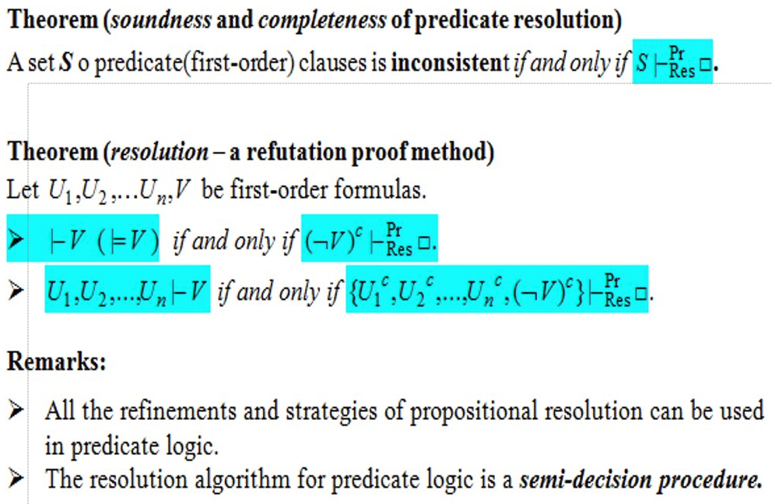
Theoretical Results

Slide 5
We consider the formulas:
U1 = (∀x)(P(x)→Q(x))→((∀x)P(x)→(∃x)Q(x))
U2 = ((∃x)P(x)∧(∃x)Q(x))→(∀x)(P(x)∧Q(x))
⊢U1 if and only if (¬U1)^{c} ⊢^{Pr}_{Res}□
⊬U2 if and only if (¬U2)^{c} ⊬^{Pr}_{Res}□

Slide 6
Normal forms
¬U1 = ¬((∀x)(P(x)→Q(x))→((∀x)P(x)→(∃x)Q(x))) replace '→'
≡ (∀x)(P(x)→Q(x))∧¬((∀x)P(x)→(∃x)Q(x))
≡ (∀x)(P(x)→Q(x))∧(∀x)P(x)∧¬(∃x)Q(x)
≡ (∀x)(¬P(x)∨Q(x))∧(∀x)P(x)∧¬(∃x)Q(x) infinitary DeMorgan's law
≡ (∀x)(¬P(x)∨Q(x))∧(∀x)P(x)∧(∀x)¬Q(x) rename variables
≡ (∀x)(¬P(x)∨Q(x))∧(∀y)P(y)∧(∀z)¬Q(z) extraction of quantifiers
(¬U1)^{p} = (∀x)(∀y)(∀z)(¬P(x)∨Q(x))∧P(y)∧¬Q(z) prenex form
(¬U1)^{S} = (∀x)(∀y)(∀z)(¬P(x)∨Q(x))∧P(y)∧¬Q(z) Skolen form
(¬U1)^{c} = (¬P(x)∨Q(x))∧P(y)∧¬Q(z) clausal normal form

Slide 7
The set of clauses:
S1 = {C1 = ¬P(x)∨Q(x), C2 = P(y), C3 = ¬Q(z)}
The resolvents:
C4 = Res^{Pr}_{[x←z]}(C1, C3) = ¬P(z)
C5 = Res^{Pr}_{[y←z]}(C2, C4) = □
Thus (¬U1)^{c} ⊢^{Pr}_{Res}□
Thus ⊢U1

Slide 8
Normal forms
¬U2 = ¬((∃x)P(x)∧(∃x)Q(x))→(∀x)(P(x)∧Q(x)) replace '→'
≡ ((∃x)P(x)∧(∃x)Q(x))∧¬(∀x)(P(x)∧Q(x)) infinitary DeMorgan's law
≡ (∃x)P(x)∧(∃x)Q(x)∧(∃x)(¬P(x)∨¬Q(x)) rename variables
≡ (∃x)P(x)∧(∃y)Q(y)∧(∃z)(¬P(z)∨¬Q(z)) extraction of quantifiers
(¬U2)^{p} = (∃x)(∃y)(∃z)P(x)∧Q(y)∧(¬P(z)∨¬Q(z)) prenex form
[x←a], [y←b], [z←c]
(¬U2)^{S} = P(a)∧Q(b)∧(¬P(c)∨¬Q(c)) Skolen form
(¬U2)^{c} = P(a)∧Q(b)∧(¬P(c)∨¬Q(c)) clausal normal form

Slide 9
The set of clauses:
S2 = {C1' = P(a), C2' = Q(b), C3' = ¬P(c)∨¬Q(c)}
P(a), P(c) and Q(b), Q(c) are not unifiable, as a, b, c are distinct constants, so the clauses C1', C2', C3' do not resolve.
Thus (¬U2)^{c} ⊬^{Pr}_{Res}□
Thus ⊬U2

